Slide 1
Introduction to Matplotlib

Slide 2
Matplotlib:
1. Its a python package used for 2d graphics.
2. Most popular plotting Library for python.
3.It gives control over every aspect of a figure.
4. It was designed to have a similar feel to Matlab’s graphical plotting
popu

Slide 3
Installation
Pip install matplotlib
Or
conda install matplotlib

Slide 4
Resource:
www.matplotlib.org

Slide 5
Continue :
Matplotlib can be divided into three parts: the frame, the plot, and the stylistic features.
plt.figure() #The Frame: We start our plot with a figure
plt.bar(x = data, height = data) #The Body
plt.title("Example Bar Plot") #Stylistic Features: Adding the title ,xlabel,y label
plt.xlabel("x axis")
plt.ylabel("y axis")
plt.xticks([0,1,2,3,4])
plt.yticks([0,2,4,6,8,10])

Slide 6
Types:
1) functional interface (also known as pyplot interface)
2)Object-oriented interface
more control when we create figures that contain multiple plots.
we create objects and do the plotting with their methods.
Methods are the functions that come with the object.
fig, ax = plt.subplots(1)
ax.plot(x, y)
ax.set_xlabel("x")
ax.set_ylabel("y")

Slide 7
Seaborn :
It is Matplotlib under the hood.
It is specially meant for statistical plotting.
used if one has to summarize data in visualizations
More integrated for working with Pandas data frames.
Both the popular visualization tools used in Python have differences in use cases, scalability and many other things. Based on these one should select the best visualization tool for a particular work. If one is doing statistics then Seaborn is a good choice because it has a lot of things suitable for statistical tasks,

Slide 8
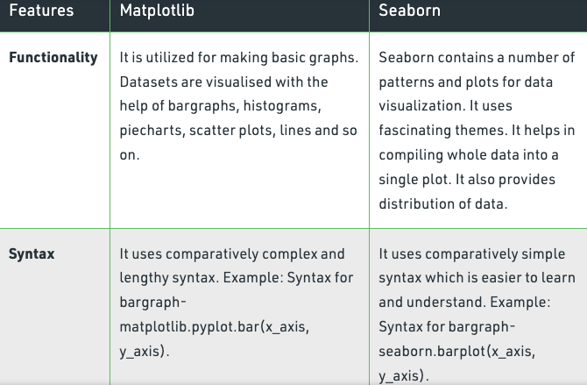
Difference between matplotlin and seaborn:

Slide 9
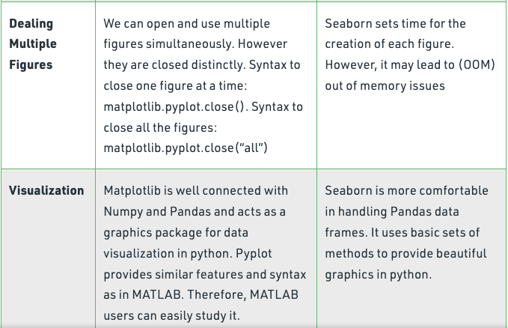
Continued:

Slide 10
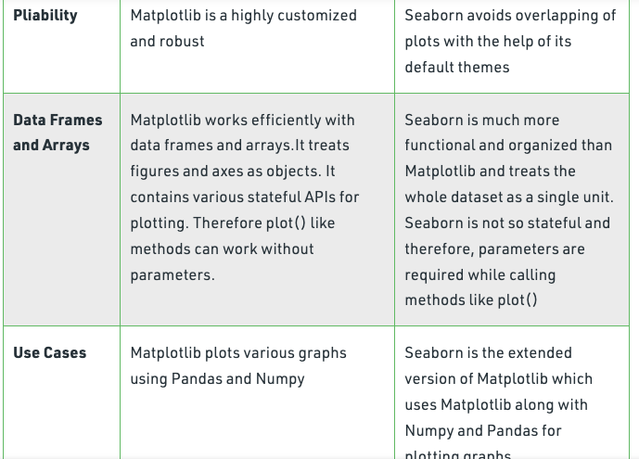
Continued:

